Slide 1
HTML BASICS
Definition
By Ronald Laz

Slide 2




Hyper Text Mark-up Language
Hyper Text is a machine-readable code

Slide 3
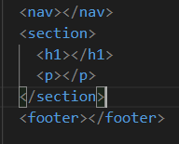
Hyper Text Mark-up Language
Mark-up means to structure in a specific format

Slide 4
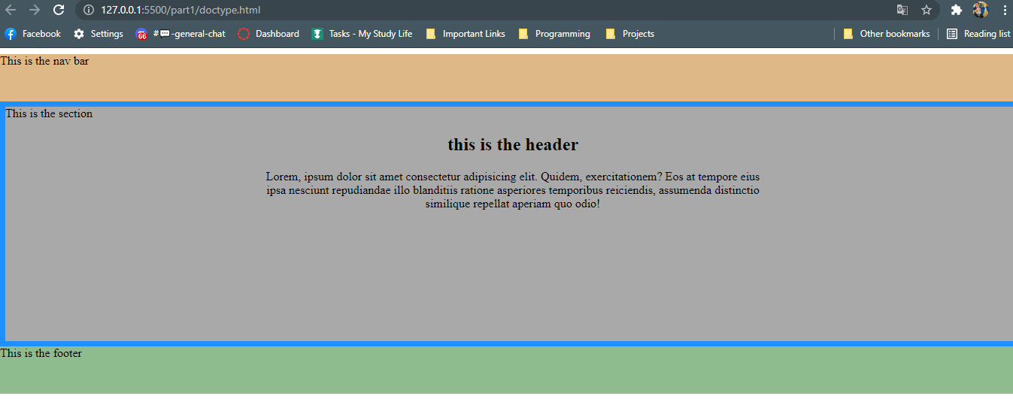

Slide 5
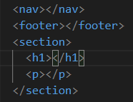
Hyper Text Mark-up Language
Mark-up means to structure in a specific format

Slide 6
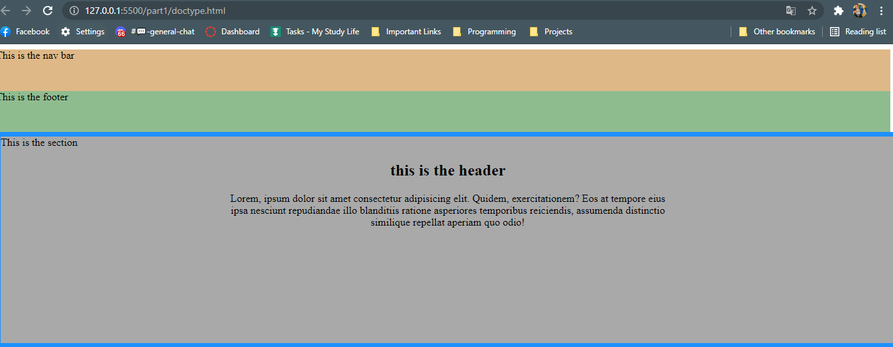

Slide 7
HTML let us communicate with the web browser to display our codes in an organize manner

Slide 8
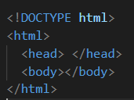

Slide 9
HTML BASICS
4 Important tags
PART 1
By Ronald Laz

Slide 10





Slide 11
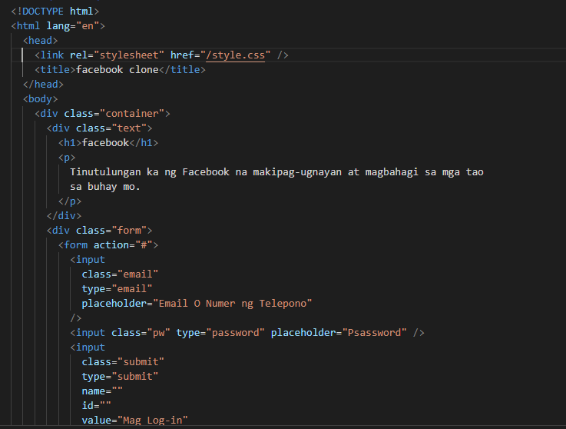
from top
To bottom

Slide 12
- It is declaration that tells our browser the we are using HTML5
- It is written in line 1

Slide 13


Image in this part is from https://www.w3schools.com/tags/tag_doctype.asp

Slide 14
What will happen if we don’t write
We are using HTML5 because it is the latest version and because of it’s new features.
If you don’t declare the doctype you might encounter some bugs from the previous version
New feature of HTML 5 might not work in your project https://www.geeksforgeeks.org/difference-between-html-and-html5/

Slide 15
See you in part 2 where we will discuss the <head></head> tag

Slide 16
HTML BASICS
4 Important tags
PART 2
By Ronald Laz

Slide 17

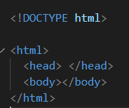
This is the main container/folder that contains all of your HTML elements
This are the contents of the HTML container

Slide 18
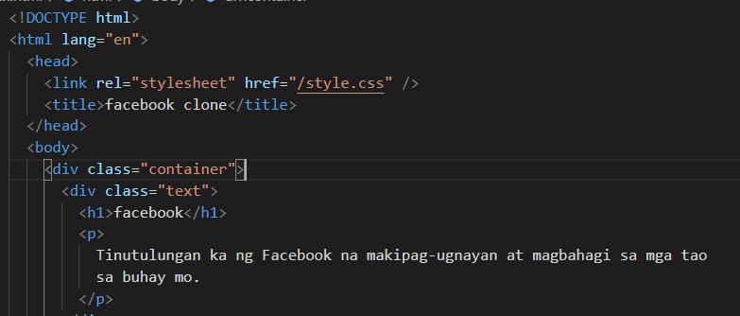
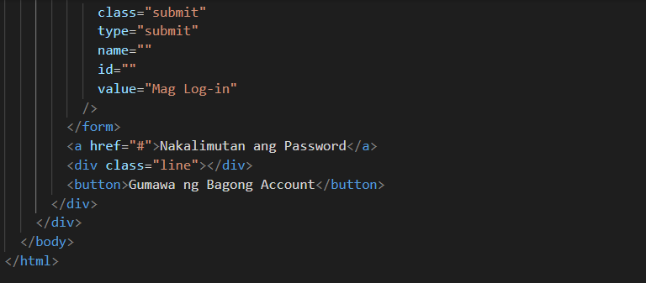

Slide 20
HTML BASICS
4 Important tags
PART 3
By Ronald Laz

Slide 21

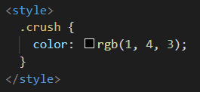


Head tag is a container that contains information that describes/style your html project

Slide 22
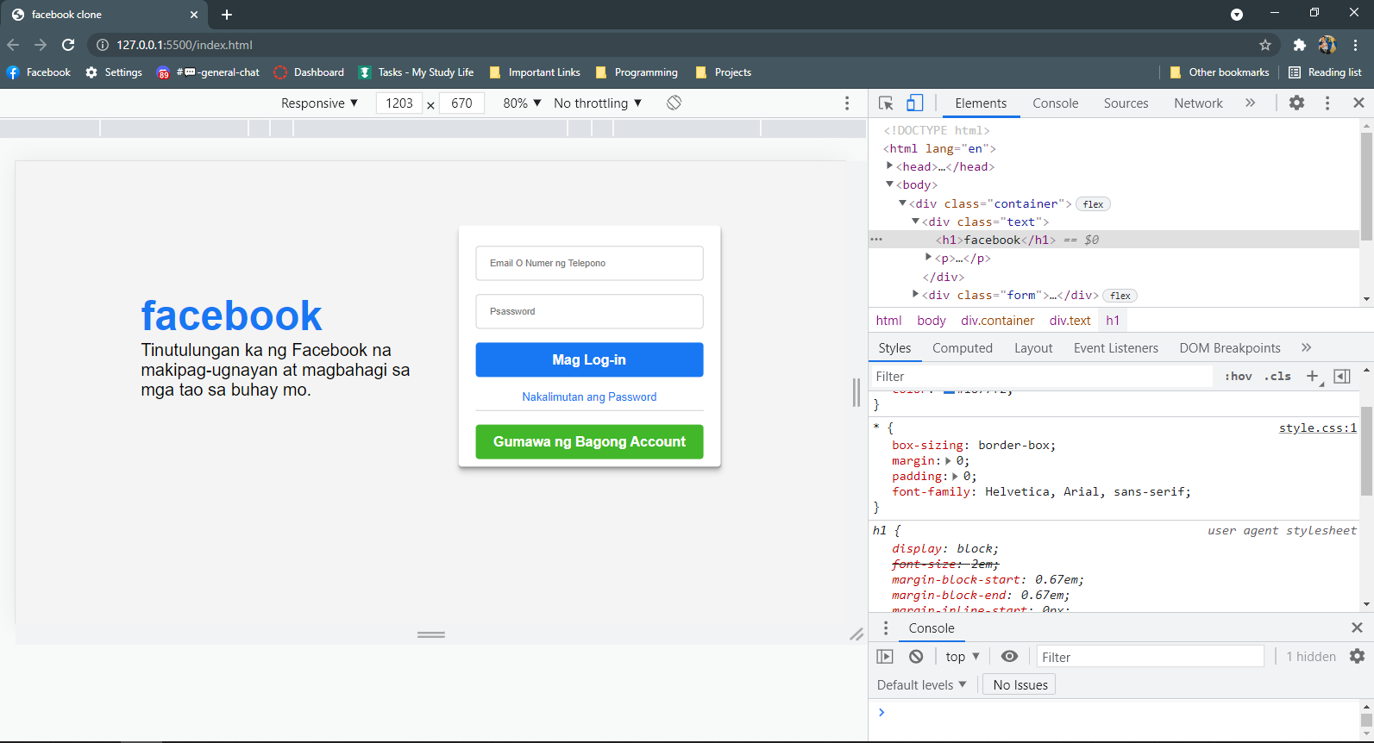
BODY
HEAD

Slide 23


Slide 24
HTML BASICS
Tags you can find inside the html body
PART 1
By Ronald Laz

Slide 25
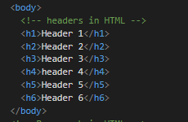
1 is the biggest – 6 is the smallest
Headers

Slide 26
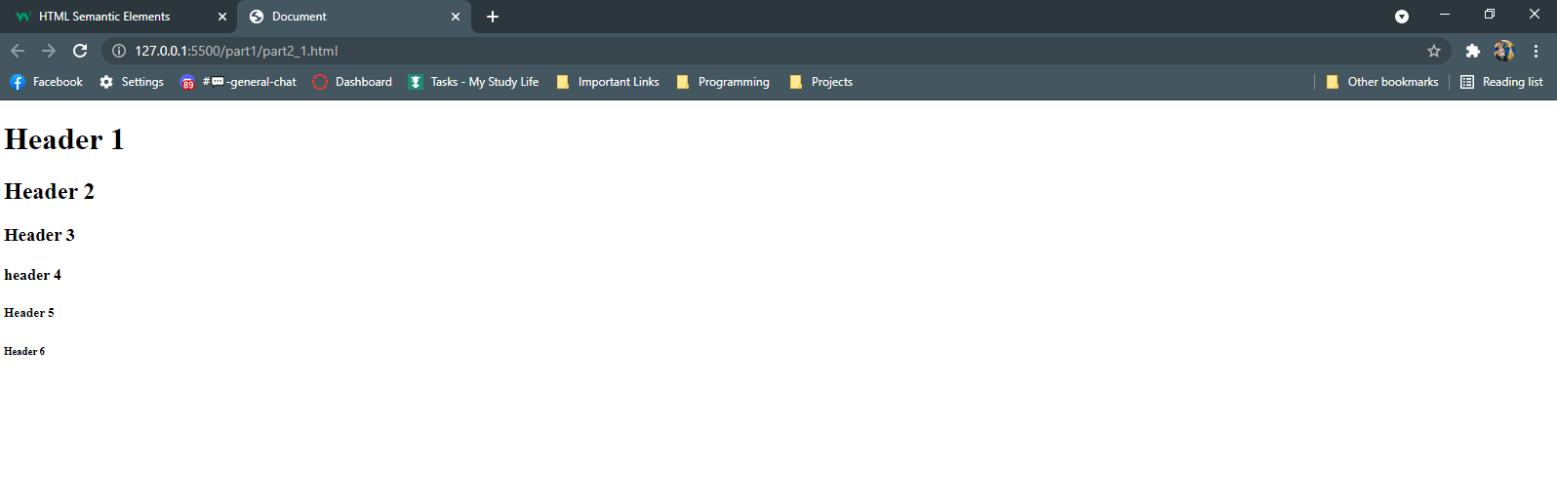
In the browser it looks like this

Slide 27

Fix size in HTML
Paragraph

Slide 28
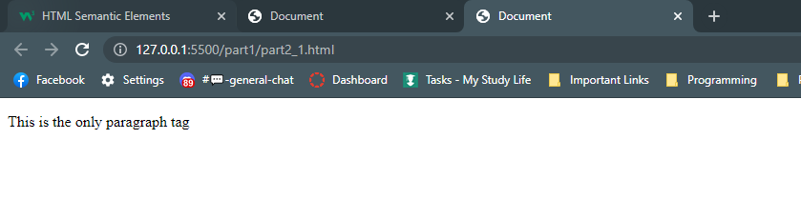
In the browser it looks like this

Slide 29
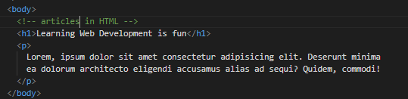
Combination

Slide 30
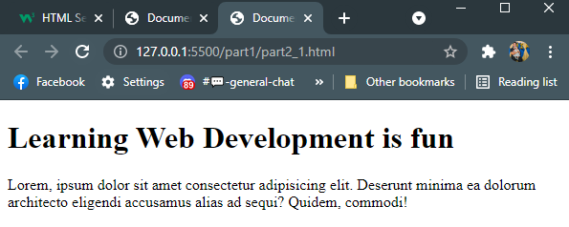

Slide 31


Slide 32
HTML BASICS
Tags you can find inside the html body
PART 2
By Ronald Laz

Slide 33
Divs and Span are the most common container in html.
Divs are block element
Span are inline element

Slide 34

Block element
Inline element
Element 1
Element 1
Element 2
Element 2

Slide 35


Block element
Inline element

Slide 36
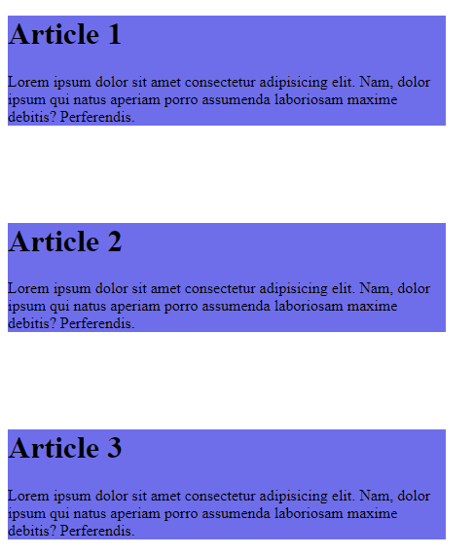

Common use
Divs are used in the layout, articles, grid etc
Spans are used to style certain words om HTML

Slide 37
SEMANTIC HTML

Slide 38
HTML BASICS
Tags you can find inside the html body
Semantic tags
By Ronald Laz

Slide 39
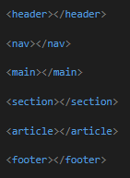
- Semantic HTML Tags are simply a div container
SEMANTIC HTML
- They are Block elements

Slide 40


Why do I need to use Semantic tags instead of using div only?
The shorter the better

Slide 41
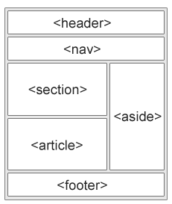
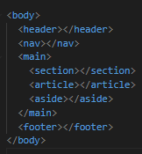

Slide 42
HTML BASICS
Tags you can find inside the html body
Buttons and a tag
By Ronald Laz

